Slide 1
Synchronous & Asynchronous Programming in JavaScript

Slide 2
What is Synchronous Programming?
Synchronous (Sync)
Code executes line-by-line
Next line waits until current line finishes
Blocking in nature
Traditional programming style

Slide 3
What is Asynchronous Programming?
Asynchronous (Async)
Code does not block
Long operations run in background
JS continues executing the next lines
Result comes later

Slide 4
Threads Overview
What are Threads?
Thread = execution path
Browser is NOT single-threaded
Browser has multiple threads:
Timer thread
Network thread
Rendering thread
File I/O thread
Web Workers
JS uses them indirectly via Web APIs.
JavaScript Threading
JS is single-threaded
Only one line executes at a time

Slide 5
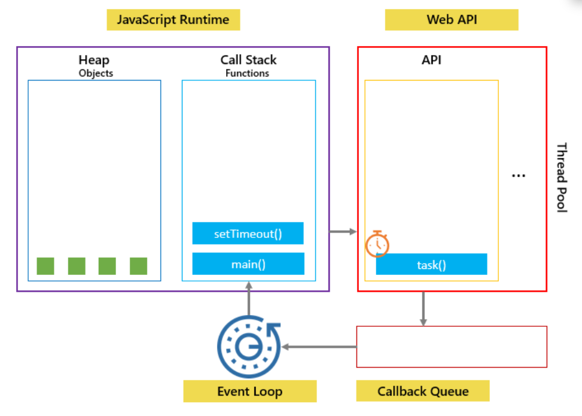
JS Is Single-Threaded But Async?
How can JS be async if it's single-threaded?
Because JS uses:
Call Stack
Web APIs (browser threads)
Callback Queue
Event Loop
These allow async behaviour without blocking JS thread

Slide 6
REPL
REPL → Read Evaluate Print Loop
Reads user input
Evaluates code
Prints output
Loops
Node.js has REPL. Browser console also behaves like REPL.

Slide 7
Date API Basics
new Date()
Returns current date & time
Common functions:
d.getFullYear()
d.getMonth() (0–11)
d.getDate()
d.getHours()
d.getMinutes()
d.getSeconds()
d.getTime() → timestamp

Slide 8
setTimeout
setTimeout(callback, delay)
Runs after delay ms
Does not block code

Slide 9
setInterval
setInterval(callback, delay)
Runs repeatedly after every delay ms

Slide 10
Callbacks
Callback
A function passed as argument.
Why Callbacks? Handle async actions:
file reading
timers
API calls
events

Slide 11
Callback Hell
Callback Hell = Pyramid of Doom
When callbacks inside callbacks inside callbacks:
Problems:
Hard to read
Hard to debug
Hard to maintain

